Slide 1
DEMAND
It is the DESIRE backed by:
The ABILITY
AND
The WILLINGNESS
To PAY THE PRICE
To PAY THE CURRENT MARKET PRICE

Slide 2
Demand (contd.)
Hence, D = f(A, W)
Venn Diagrams used to depict Ability and Willingness:
Intersecting sets
Intersection Means ??
Ability
Willingness
Ability
Willingness
Disjoint sets
Must they be Congruent sets?
How does one make ‘A’ or ‘W’ favourable for a firm?
A
W
W
A
UNEQUAL sets ??

Slide 3
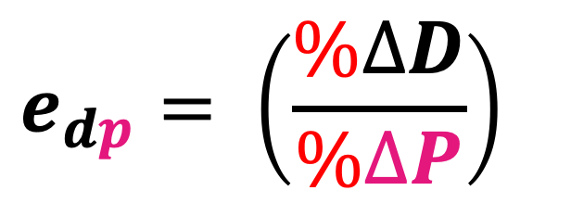
Elasticity of Demand
$$e_{dp}= \left(\frac{\%∆D}{\%∆P}\right)$$
Stimuli
Technical Term
Symbol
Price of the Concerned Good
Price Ed
E_{dp}
Income of Potential Consumers
Income Ed
E_{dY}
Price of a Related Good
Cross Ed
E_{dXY}
Promotions
Promotional Ed
E_{dA}

Slide 4
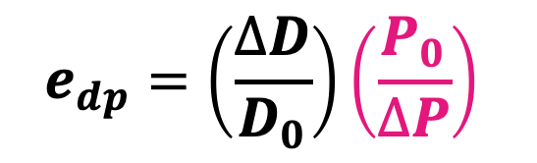
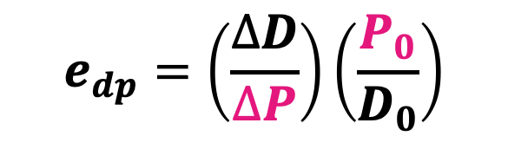
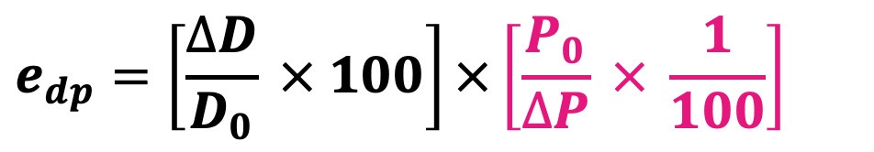
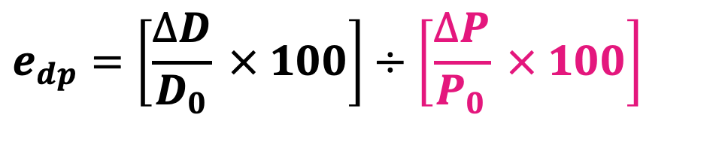


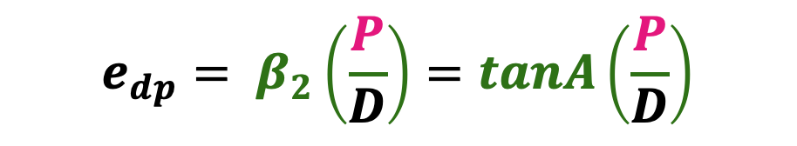
Demand and Elasticity (= Responsiveness)
$$e_{dp}= \left(\frac{∆D}{∆P}\right)$$
$$e_{dp}= \left(\frac{\%∆D}{\%∆P}\right)$$
$$e_{dp}=\left[\frac{∆D}{D_{0}} × 100\right]÷\left[\frac{∆P}{P_{0}} × 100\right]$$
$$e_{dp}=\left[\frac{∆D}{D_{0}} × 100\right]×\left[\frac{P_{0}}{∆P} × \frac{1}{100}\right]$$
$$e_{dp}=\left(\frac{∆D}{D_{0}}\right)\left(\frac{P_{0}}{∆P}\right)$$
$$e_{dp}=\left(\frac{∆D}{∆P}\right)\left(\frac{P_{0}}{D_{0}}\right)$$
$$e_{dp}= β_{2}\left(\frac{P}{D}\right)=tanA\left(\frac{P}{D}\right)$$

Slide 5


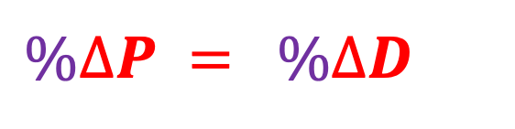

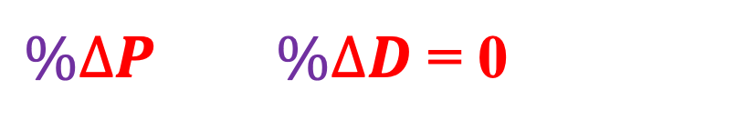


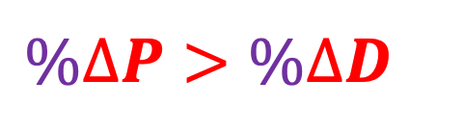
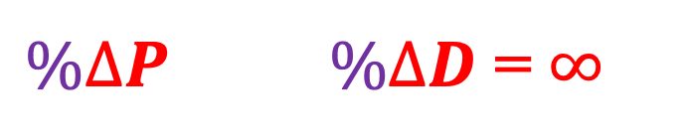

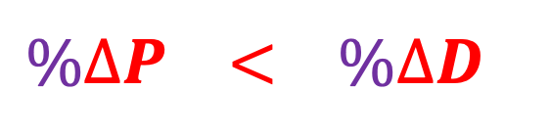
Demand and Degrees of Elasticity
$$e_{dp}= \left(\frac{\%∆D}{\%∆P}\right)$$
$\%∆P \%∆D$ = 0
Perfectly Inelastic $Demand$
E_{dp} = 0
$\%∆P>\%∆D$
Relatively I$nelastic Demand$
E_{dp} < 1
$$\%∆P = \%∆D$$
$$Unitary Elastic Demand$$
E_{dp} = 1
$$\%∆P < \%∆D$$
$$Relatively Elastic Demand$$
E_{dp} > 1
$\%∆P \%∆D$ = $∞$
Perfectly Elastic Demand
E_{dp} = $∞$

Slide 6
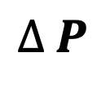
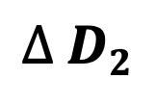
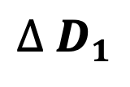
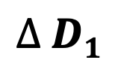
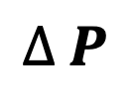
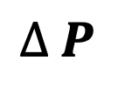
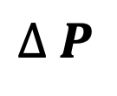
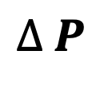
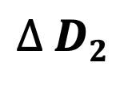
Demand and Elasticity (= Responsiveness)
Demand
$$∆ D1$$
$$∆ D2$$
$$∆ D2$$
$$∆ P$$
$$∆ P$$
$$∆ P$$
$$∆ D1$$
RIE
$$∆ P$$
RE
A
B
$$∆ P$$
Price

Slide 7
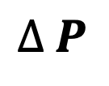
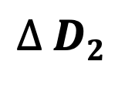
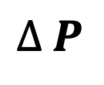
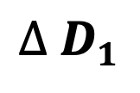
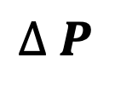
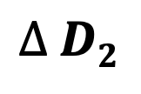
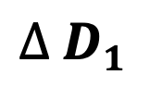
Demand and Elasticity (= Responsiveness)
Marshallian Mode
Price
$$∆ P$$
$$∆ P$$
$$∆ D1$$
$$∆ D2$$
$$∆ P$$
$$∆ P$$
$$∆ P$$
$$∆ D2$$
RE
$$∆ D1$$
RIE
A
B
Demand

Slide 8
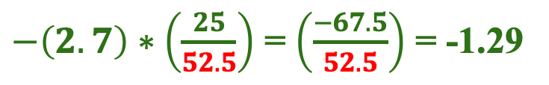




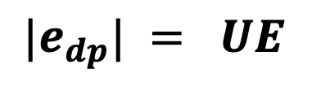
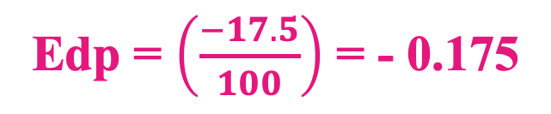

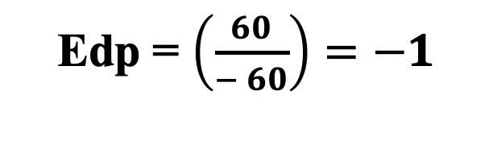

Demand and Elasticity (= Responsiveness)
Price Elasticity of Demand
$e_{dp}=\frac{\% ∆Dx}{\% ∆Px}=\left(\frac{∆Dx}{∆Px}\right)\left(\frac{P_{x0}}{D_{x0}}\right)= β_{2}\left(\frac{Px}{Dx}\right)$ = $\left(\frac{AR}{AR −MR}\right)$ = $\left(\frac{Lower Seg}{Upper Seg}\right)$
Px | Dx
10 | 400
20 | 330
Px | Dx
25 | 550
10 | 880
D_{x} = 120 - 2.7P_{x}
At P_{x} = 25, E_{dp} = ?
Given
Slope = - 2.7
P_{x} = 25
Edp = $\left(\frac{−70}{10}\right)\left(\frac{10}{400}\right)$ = -0.175
Edp = $\left(\frac{−17.5}{100}\right)$ = - 0.175
Edp = $\left(\frac{60}{− 60}\right)=−1$
D_{x} = 120 - 2.7(25)
D_{x} = 52.5
$${|e}_{dp}| = RIE$$
$${|e}_{dp}| = UE$$
$−\left(2.7\right)∗\left(\frac{25}{52.5}\right)$ = $\left(\frac{−67.5}{52.5}\right)$ = -1.29
$$−0.45$$
$${|e}_{dp}| = RE$$
$$\frac{−17.5}{100}=$$
$\frac{27.27}{−60}$ =

Slide 9

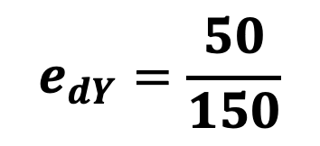
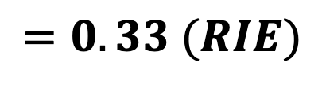
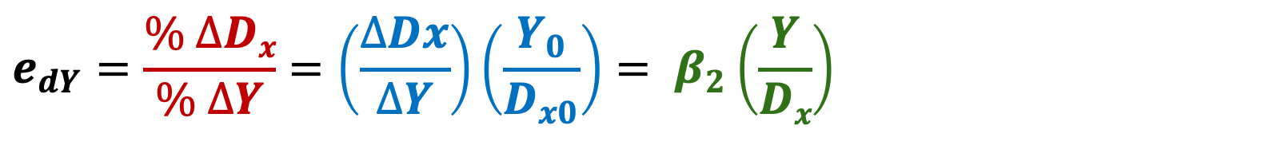
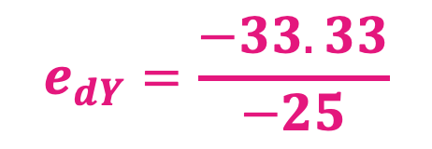
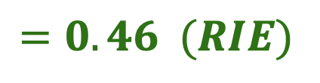
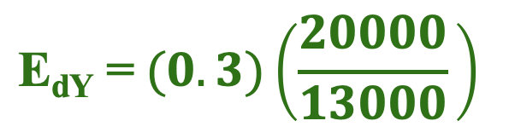
Demand and Elasticity (= Responsiveness) contd.
Income Elasticity of Demand
$$e_{dY}=\frac{\% ∆Dx}{\% ∆Y}=\left(\frac{∆Dx}{∆Y}\right)\left(\frac{Y_{0}}{D_{x0}}\right)= β_{2}\left(\frac{Y}{Dx}\right)$$
D_{x} = 7000 + 0.3Y
Income | Demand
10000 | 400
25000 | 600
Income | Demand
100000 | 600
75000 | 400
At Y = 20k, E_{dY} = ?
Given:
Slope = + 0.3
Y = 20000
$$e_{dY}=\frac{50}{150}$$
$$e_{dY}=\frac{−33.33}{−25}$$
D_{x} = 7000 + 0.3*20000
D_{x} = 13000
$$=0.33 (RIE)$$
$$=1.33 (RE)$$
$$\text{E}\text{dY}\text{ =} (0.3)\left(\frac{20000}{13000} \right)$$
$$=0.46 (RIE)$$

Slide 10
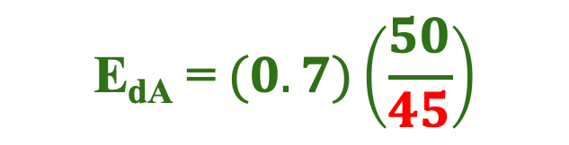
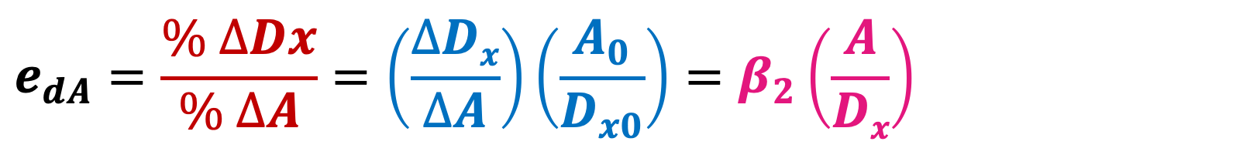
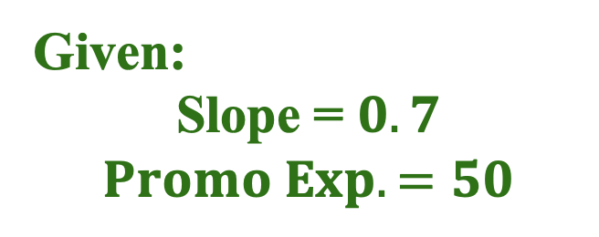
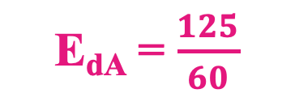
Demand and Elasticity (= Responsiveness) contd.
Promotional Elasticity of Demand
$$e_{dA}=\frac{\% ∆Dx}{\% ∆A}=\left(\frac{∆Dx}{∆A}\right)\left(\frac{A_{0}}{D_{x0}}\right)=β_{2}\left(\frac{A}{Dx}\right)$$
Promo Exp. | Demand
50 | 400
80 | 900
D_{x} = 10 + 0.7A
At A = 50, E_{dA} = ?
Given:
$$\text{Slope}\text{ = }0.7$$
$$Promo Exp. =50$$
E_{dA} = $\frac{125}{60}$
D_{x} = 10 + 0.7*50 = 45
= 2.08 (RE)
$$\text{E}\text{dA}\text{ =} (0.7)\left(\frac{50}{45}\right)$$
= 0.77 (RIE)

Slide 11
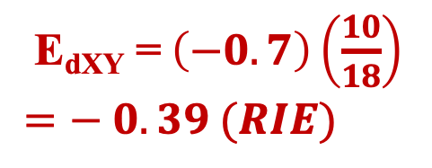
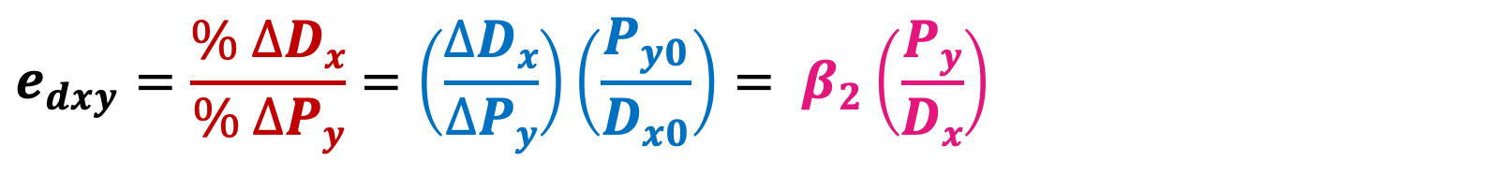
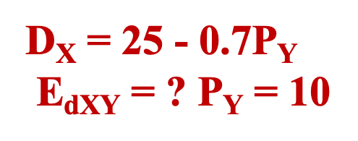
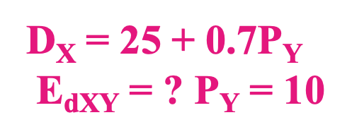
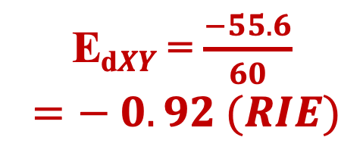
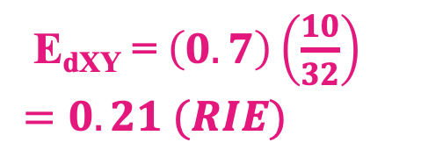
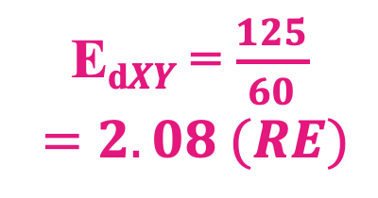
Demand and Elasticity (= Responsiveness) contd.
Cross Elasticity of Demand
$$e_{dxy}=\frac{\% ∆Dx}{\% ∆Py}=\left(\frac{∆Dx}{∆Py}\right)\left(\frac{P_{y0}}{D_{x0}}\right)= β_{2}\left(\frac{Py}{Dx}\right)$$
Competitive / Substitute Goods
Supportive / Complementary Goods
P_{Y} D_{Y} D_{X}
P_{Y} D_{Y} D_{X}
P_{Y} | D_{X}
50 | 400
80 | 900
P_{Y} | D_{X}
50 | 900
80 | 400
E_{d}$XY$ = $\frac{125}{60}$
$$=2.08 (RE)$$
E_{d}$XY$ = $\frac{−55.6}{60}$
$$=− 0.92 (RIE)$$
Py
Py
D_{X} = 25 + 0.7P_{Y}
$\text{E}\text{dXY}$ = ? P_{Y} = 10
D_{X} = 25 - 0.7P_{Y}
$\text{E}\text{dXY}$ = ? P_{Y} = 10
$\text{E}\text{d}\text{XY}\text{ =} \left(0.7\right)\left(\frac{10}{32}\right)$
$=0.21 (RIE)$
$\text{E}\text{d}\text{XY}\text{ =} \left(−0.7\right)\left(\frac{10}{18}\right)$
$=− 0.39 (RIE)$
Dx
Dx

